Slide 1


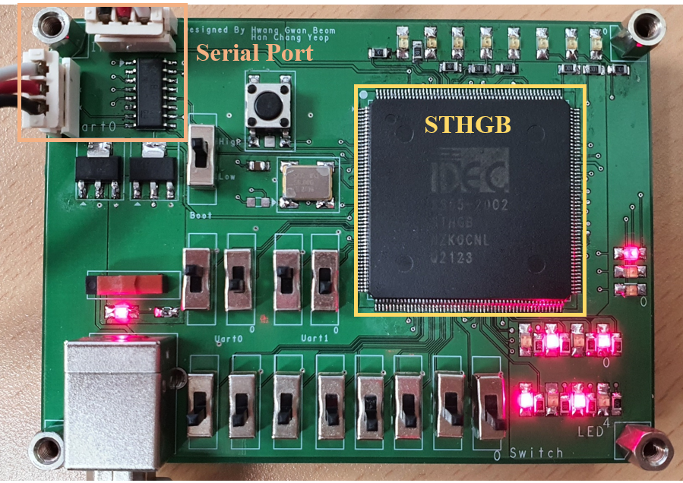
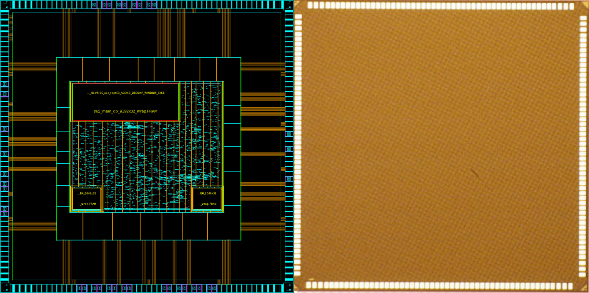
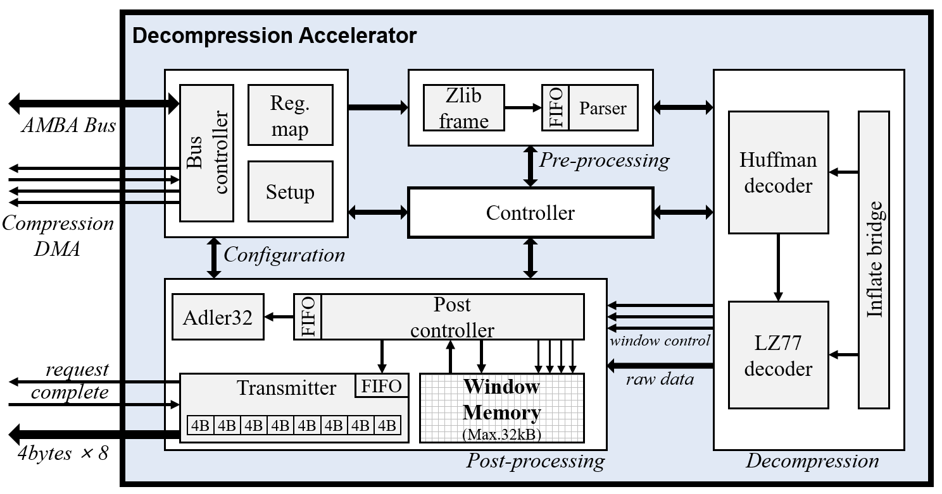
Implementation of Lossless Decompression Accelerator Based on Inflate Algorithm
Gwan Beom Hwang, Do Young Choi, Chang Yeop Han, Hyun Woo Oh, Sun Beom Kwon, and Seung Eun Lee
Dept. of Electrical Engineering
Seoul National University of Science and Technology
Abstract
Chip Verification
We propose the lossless decompression accelerator based on inflate algorithm. We aimed to design the inflate core that decodes the deflate format with an appropriate trade-off. The inflate core enhances the processing speed of the inflate process by means of pipelining and the specified bitwise operation. The accelerator with the bus interface is combined with system peripherals to reduce the workload of the main processor. We fabricated the accelerator with Samsung 65 nm RFCMOS technology. Our design operates in 1.8V, 50MHz. Our circuit type is Digital.
The verification environment consists of the host PC and the prototype PCB including the STHGB with serial port. We utilized MATLAB R2020b for serial communi-cation and software verification. However, we analyzed that the outputs of the STHGB were not matched with the software decompression result. We will debug the exact issue and improve our system.
ZLIB Format
1-byte
1-byte
N-byte
4-byte
CMF
FLG
Deflate Data
Adler32
1-bit
2-bit
5-bit
1-byte
BFINAL
BTYPE
Data stream
(according to BTYPE)
Data stream
(according to BTYPE)
Data stream
(according to BTYPE)
[Verification environment]
[ZLIB format architecture]
Chip Implementation
Decompression Accelerator
[Chip layout and photograph]
Chip Specification
Technology | 65nm RFCMOS
Supply Voltage | 1.8V
Chip Size | 4mm x 4mm
Operating Frequency | 50MHz
[Block diagram of decompression accelerator]
Benchmark Result
The decompression accelerator based on the inflate algorithm consists of the Configuration, Pre-processing, Decompression, and Post-processing domain. The pre-processing domain aligns the boundary with 32-bit unit for the compatibility with system bus data input. In the Decompression domain, the decompression is performed by receiving input data from the parser module in nine-bit unit. The post-processing domain performs read/write operation to the window memory according to the data of the previous domain. Moreover, the post-processing domain outputs raw data to the external memory in 32-byte unit.
File | Raw Data (Bytes) | CR (%) | Time(us) | Throughput (MB/s)
alice29 | 152,089 | 57.4 | 24,323 | 6.3
Asyoulik | 125,179 | 52.7 | 22,217 | 5.6
Cp | 24,604 | 62.2 | 3524 | 7.0
Fields | 11,150 | 68.0 | 1341 | 8.3
Grammar | 3,721 | 61.1 | 543 | 6.9
Acknowledgment
The chip fabrication and EDA tool were supported by the IC Design Education Center (IDEC), Korea.
Chip Design Contest : July 7, 2022

